Slide 1
Progress Report – Multicontact Capturability
GABRIEL ENRIQUE GARCÍA CHÁVEZ
2019

Slide 2
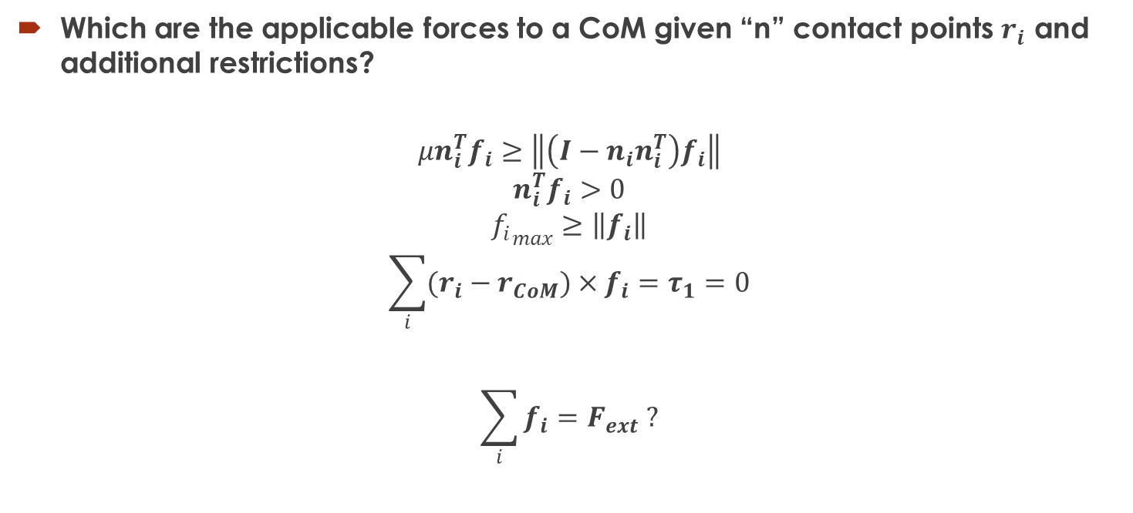
Convex Properties
Which are the applicable forces to a CoM given “n” contact points $r_{i}$ and additional restrictions?
$$μn_{i}^{T}f_{i}≥\left\|\left(I−n_{i}n_{i}^{T}\right)f_{i}\right\|$$
$$n_{i}^{T}f_{i}>0$$
$${f_{i}}_{max}≥\left\|f_{i}\right\|$$
$$\sum_{i}{(r_{i}−r_{CoM})×f_{i}}=τ_{1}=0$$
$$\sum_{i}{f_{i}}=F_{ext} ?$$

Slide 3
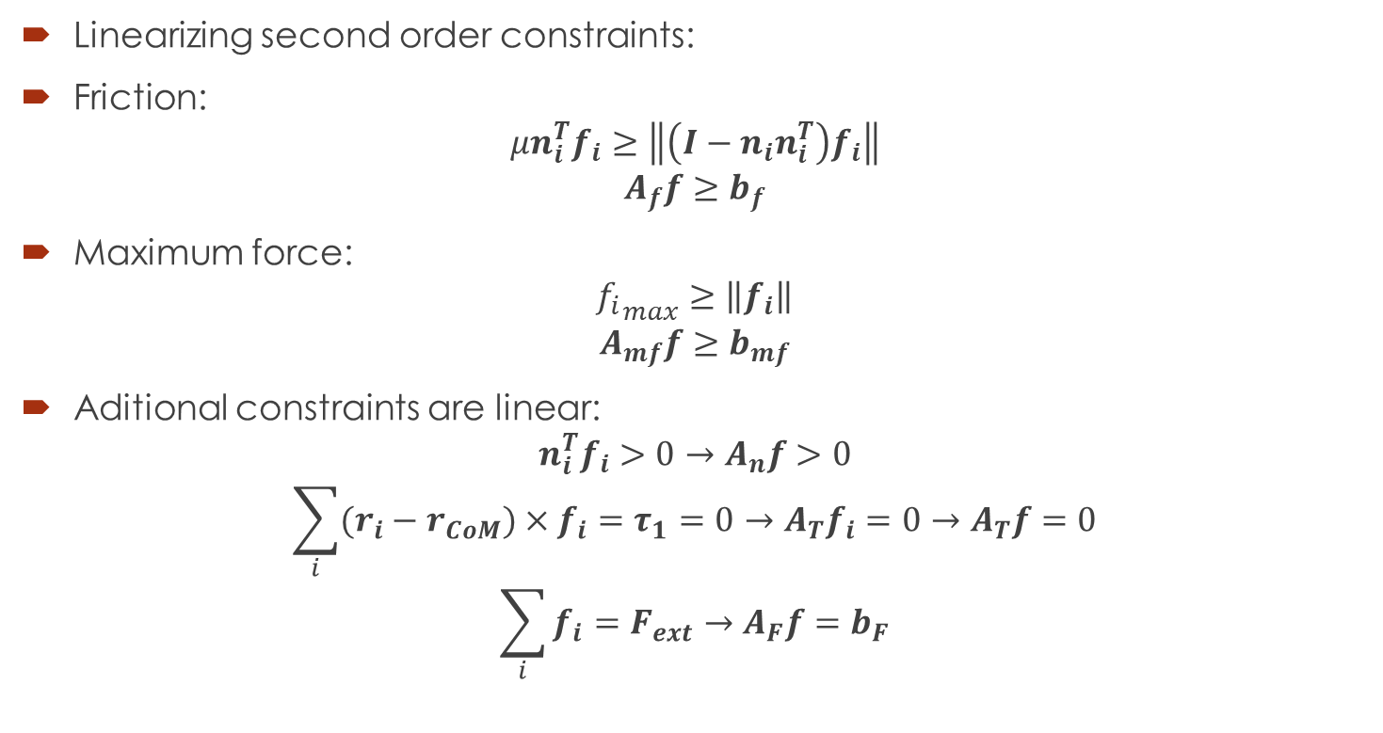
Convex Properties
Linearizing second order constraints:
Friction:
$$μn_{i}^{T}f_{i}≥\left\|\left(I−n_{i}n_{i}^{T}\right)f_{i}\right\|$$
$$A_{f}f≥b_{f}$$
Maximum force:
$${f_{i}}_{max}≥\left\|f_{i}\right\|$$
$$A_{mf}f≥b_{mf}$$
Aditional constraints are linear:
$$n_{i}^{T}f_{i}>0→A_{n}f>0$$
$$\sum_{i}{(r_{i}−r_{CoM})×f_{i}}=τ_{1}=0→A_{T}f_{i}=0→A_{T}f=0$$
$$\sum_{i}{f_{i}}=F_{ext}→A_{F}f=b_{F}$$

Slide 4
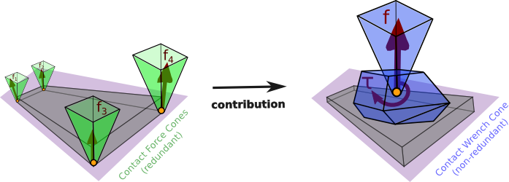
Another Perspective: CWC
All contact point forces with restrictions can be reduced to only a wrench independent of the Center of Mass.

Slide 5







Convex Properties
Finding transversal surface for given ${\hat{F}}_{ext}$: Example of LP program:
1. Pick a random $r_{CoM0}$
2. Pick a random ${\hat{v}}_{j}$ holding ${\hat{v}}_{j}∙F_{ext}=0$. Can be defined by just an angle (1D).
3.$\max_{r_{CoM1},f}\left(r_{CoM1}−r_{CoM0}\right)∙{\hat{v}}_{j}$ s.t
$$W_{T}f_{CWC}=0$$
$$\left(r_{CoM1}−r_{CoM0}\right)∙W_{F}f_{CWC}=0$$
$$F_{ext}$$
$${\hat{v}}_{j}$$
$$r_{CoM1}$$
$$r_{CoM0}$$
$${\hat{v}}_{j}$$

Slide 6
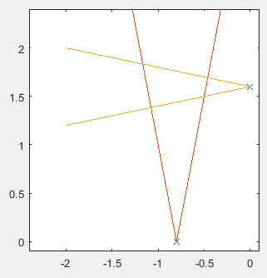
Back to Capturability - More complexity
At least 2 non-coplanar contact points w/Friction Constraints
Each subregion in the cutted space has it’s own Center of Pressure/Attraction region.

Slide 7

Back to Capturability - More complexity
At least 2 non-coplanar contact points w/Friction Constraints :
System equivalent to 2D VHIP var. CoP with CoM-dependent Contact Surface.
In that particular case: Still Necessary and sufficient: $∃r_{P}∈CH$ with $z_{c}>0$.

Slide 8

Full Reduced Inverted Pendulum
Reduced Model of a mechanism:
$$\left\{\begin{aligned}\dot{L}=τ\hat{n}+(r_{p}−r)×f \\ \ddot{r}=\frac{1}{m}f+g \end{aligned}\right.$$

Slide 9
CWC
All contact point forces with restrictions can be reduced to only a wrench independent of the Center of Mass.

Slide 10

Full Reduced Inverted Pendulum
Using CWC:
$$ζ=\left[\begin{aligned}f \\ τ\end{aligned}\right]$$
$$\left\{\begin{aligned}\dot{L}=τ+(r_{p0}−r)×f \\ \ddot{r}=\frac{1}{m}f+g \end{aligned}\right.,W_{CWC}ζ≤b_{CWC}$$
Use instead
$$L_{2}=L+m(r×\dot{r})$$

Slide 11

Full Reduced Inverted Pendulum
Reduced Model of a mechanism
$$\left\{\begin{aligned}\dot{L}=τ+(r_{p0}−r)×f \\ \ddot{r}=\frac{1}{m}f+g \end{aligned}\right.,W_{CWC}ζ≤b_{CWC}$$
Use instead
$$L_{2}=L−m(r×\dot{r})$$
$${\dot{L}}_{2}=τ+r_{p0}×f+mr×g$$
Affine system!

Slide 12
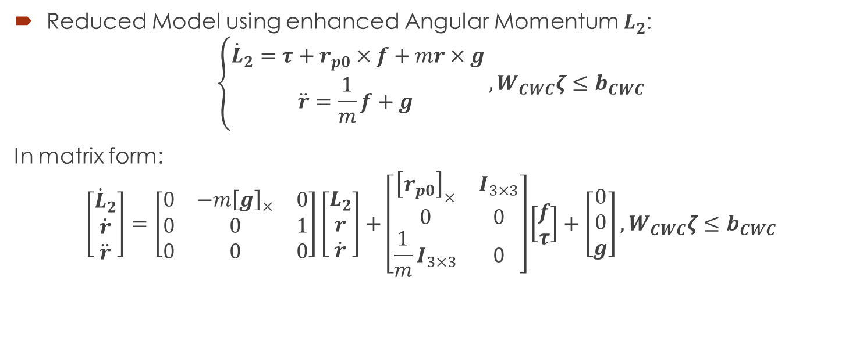
Full Reduced Inverted Pendulum
Reduced Model using enhanced Angular Momentum $L_{2}$:
$$\left\{\begin{aligned}{\dot{L}}_{2}=τ+r_{p0}×f+mr×g \\ \ddot{r}=\frac{1}{m}f+g \end{aligned}\right.,W_{CWC}ζ≤b_{CWC}$$
In matrix form:
$$\left[\begin{aligned}{\dot{L}}_{2} \\ \dot{r} \\ \ddot{r}\end{aligned}\right]=\left[\begin{matrix}0 & −m{\left[g\right]}_{×} & 0 \\ 0 & 0 & 1 \\ 0 & 0 & 0\end{matrix}\right]\left[\begin{aligned}L_{2} \\ r \\ \dot{r}\end{aligned}\right]+\left[\begin{matrix}{\left[r_{p0}\right]}_{×} & I_{3×3} \\ 0 & 0 \\ \frac{1}{m}I_{3×3} & 0\end{matrix}\right]\left[\begin{aligned}f \\ τ\end{aligned}\right]+\left[\begin{aligned}0 \\ 0 \\ g\end{aligned}\right],W_{CWC}ζ≤b_{CWC}$$

Slide 13

Full Reduced Inverted Pendulum
Reduced Model using enhanced Angular Momentum $L_{2}$:
$$\left\{\begin{aligned}{\dot{L}}_{2}=τ+r_{p0}×f+mr×g \\ \ddot{r}=\frac{1}{m}f+g \end{aligned}\right.,W_{CWC}ζ≤b_{CWC}$$
In matrix form:
$$\dot{x}=Ax+Bζ+c,W_{CWC}ζ≤b_{CWC}$$

Slide 14
Full Reduced Inverted Pendulum
Reduced Model using enhanced Angular Momentum $L_{2}$:
$$\left\{\begin{aligned}{\dot{L}}_{2}=τ+r_{p0}×f+mr×g \\ \ddot{r}=\frac{1}{m}f+g \end{aligned}\right.,W_{CWC}ζ≤b_{CWC}$$
In matrix form:
$$\dot{x}=Ax+Bζ+c, W_{CWC}ζ≤b_{CWC}$$

Slide 15
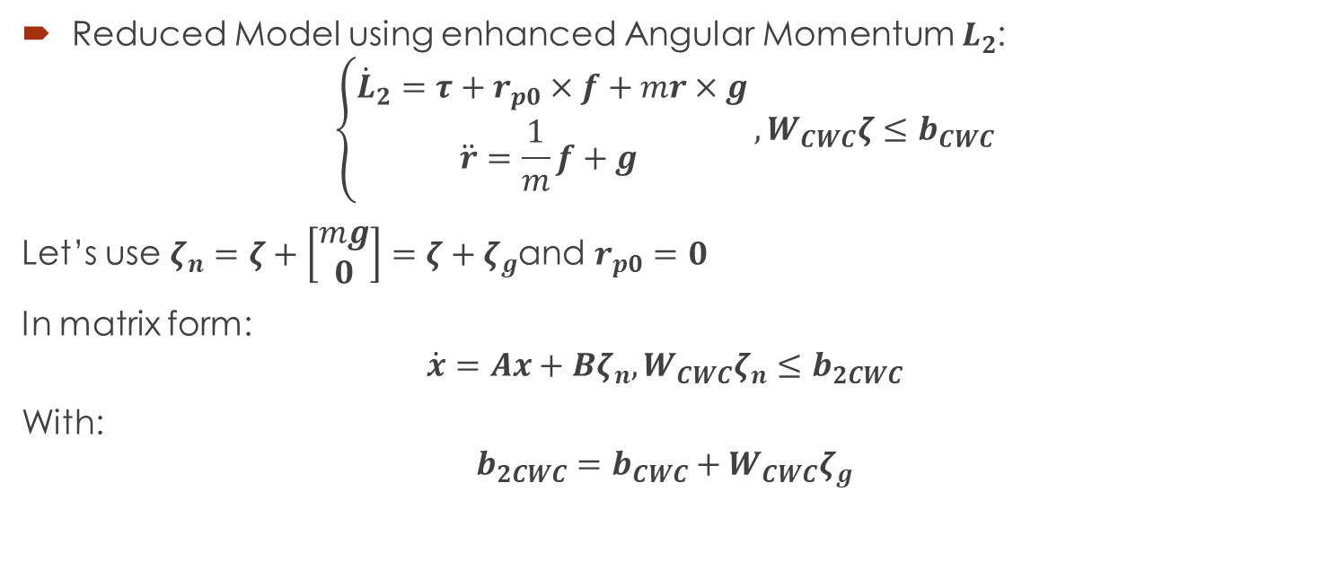
Full Reduced Inverted Pendulum
Reduced Model using enhanced Angular Momentum $L_{2}$:
$$\left\{\begin{aligned}{\dot{L}}_{2}=τ+r_{p0}×f+mr×g \\ \ddot{r}=\frac{1}{m}f+g \end{aligned}\right.,W_{CWC}ζ≤b_{CWC}$$
Let’s use $ζ_{n}=ζ+\left[\begin{aligned}mg \\ 0\end{aligned}\right]=ζ+ζ_{g}$and $r_{p0}=0$
In matrix form:
$$\dot{x}=Ax+Bζ_{n}, W_{CWC}ζ_{n}≤b_{2CWC}$$
With:
$$b_{2CWC}=b_{CWC}+W_{CWC}ζ_{g}$$

Slide 16
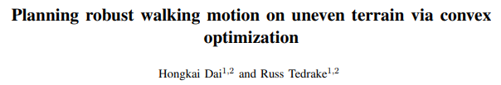
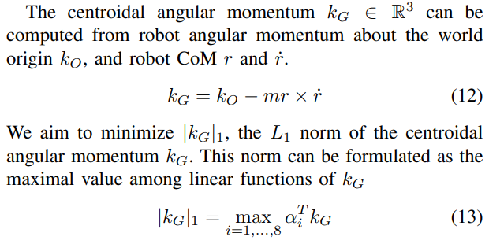

Full Reduced Inverted Pendulum
New equivalent linear system:
$$\dot{x}=Ax+Bζ_{n}, W_{CWC}ζ_{n}≤b_{2CWC}$$
What is the Enhanced Angular Momentum $L_{2}$?

Slide 17

Full Reduced Inverted Pendulum
New equivalent linear system:
$$\dot{x}=Ax+Bζ_{n}, W_{CWC}ζ_{n}≤b_{2CWC}$$
Capturability problem:
Find $ζ_{n}=ζ_{n}(x)$ or $ζ_{n}=ζ_{n}\left(t\right)$ holding:
$$x→x_{f}$$
$$ζ_{n}→ζ_{nf}$$
$$x_{f}=\left[\begin{aligned}0 \\ r_{f} \\ 0\end{aligned}\right],ζ_{nf}=\left[\begin{aligned}0 \\ −mr_{f}×g\end{aligned}\right]$$
For some $r_{f}$ in static stability region, i.e.:

Slide 18

Full Reduced Inverted Pendulum
Switch to error space:
$ζ_{ne}=ζ_{n}−ζ_{nf}$, $x_{e}=x−x_{f}$, $b_{3CWC}=b_{2CWC}−W_{CWC}ζ_{nf}$
New equivalent linear system:
$${\dot{x}}_{e}=Ax_{e}+Bζ_{ne}, W_{CWC}ζ_{ne}≤b_{3CWC}$$
Capturability problem:
$$x_{e}→0$$
$$ζ_{ne}→0$$

Slide 19
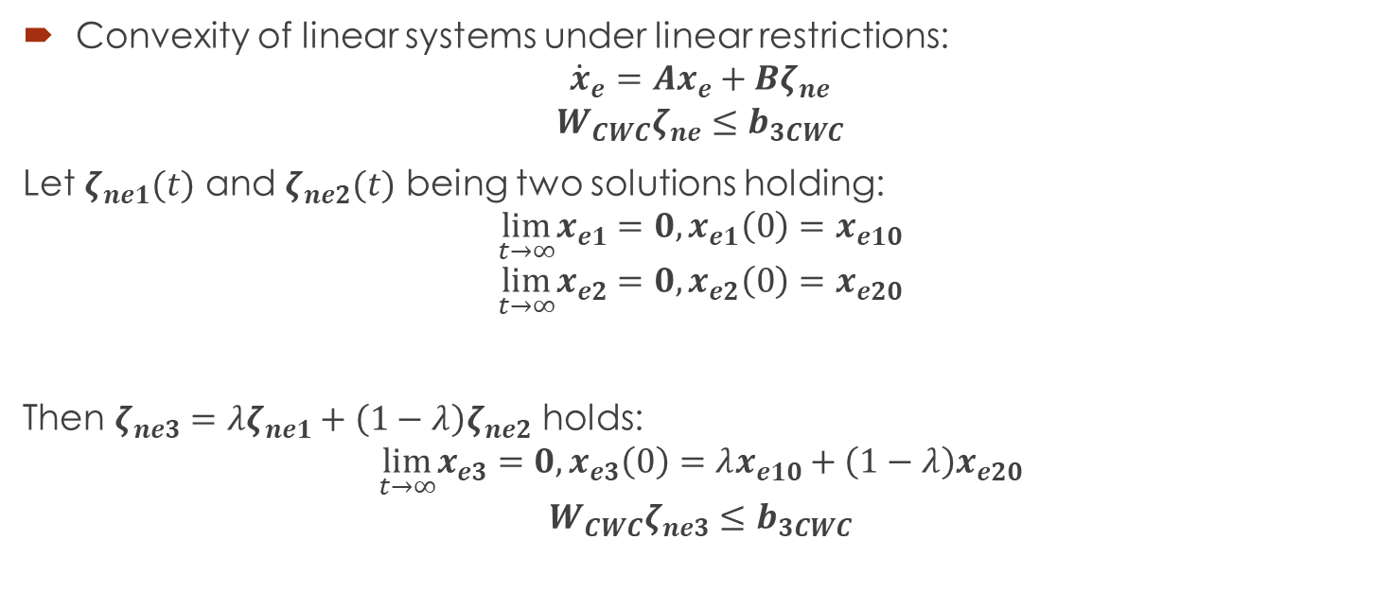
Full Reduced Inverted Pendulum
Convexity of linear systems under linear restrictions:
$${\dot{x}}_{e}=Ax_{e}+Bζ_{ne}$$
$$W_{CWC}ζ_{ne}≤b_{3CWC}$$
Let $ζ_{ne1}(t)$ and $ζ_{ne2}(t)$ being two solutions holding:
$$\lim_{t→∞}x_{e1}=0,x_{e1}\left(0\right)=x_{e10}$$
$$\lim_{t→∞}x_{e2}=0,x_{e2}\left(0\right)=x_{e20}$$
Then $ζ_{ne3}=λζ_{ne1}+\left(1−λ\right)ζ_{ne2}$ holds:
$$\lim_{t→∞}x_{e3}=0,x_{e3}\left(0\right)=λx_{e10}+\left(1−λ\right)x_{e20}$$
$$W_{CWC}ζ_{ne3}≤b_{3CWC}$$

Slide 20

Full Reduced Inverted Pendulum
Convexity of linear systems under linear restrictions:
$${\dot{x}}_{e}=Ax_{e}+Bζ_{ne}$$
$$W_{CWC}ζ_{ne}≤b_{3CWC}$$
Consequence:
If two states are capturable, then any state between them is capturable.

Slide 21
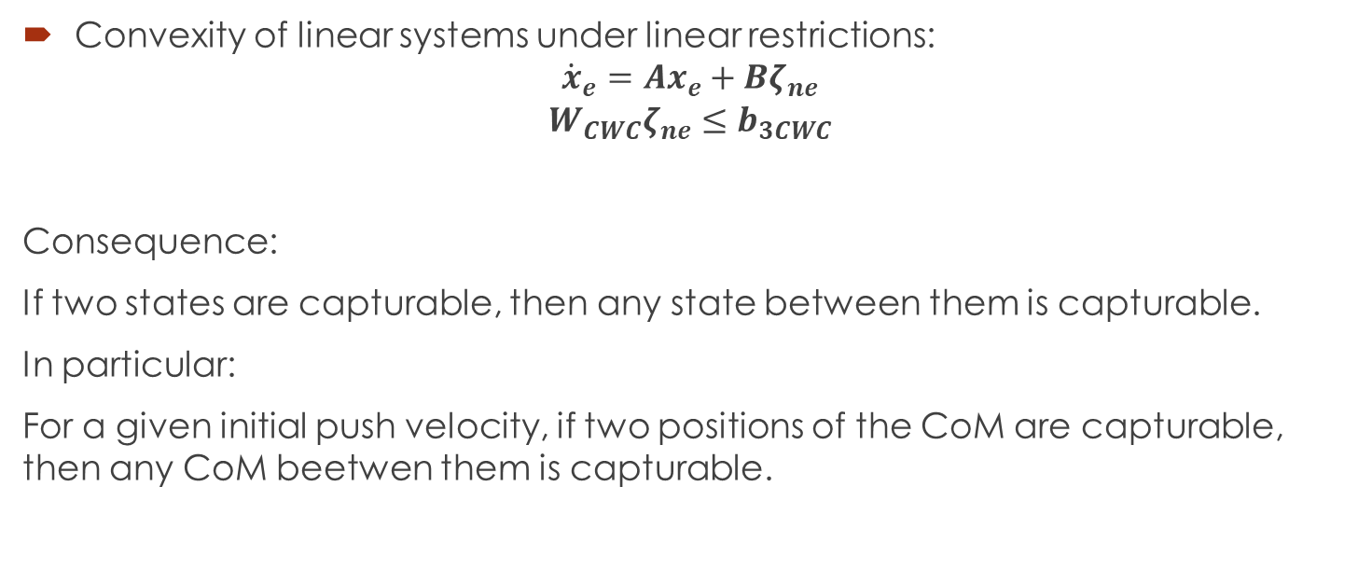
Full Reduced Inverted Pendulum
Convexity of linear systems under linear restrictions:
$${\dot{x}}_{e}=Ax_{e}+Bζ_{ne}$$
$$W_{CWC}ζ_{ne}≤b_{3CWC}$$
Consequence:
If two states are capturable, then any state between them is capturable.
In particular:
For a given initial push velocity, if two positions of the CoM are capturable, then any CoM beetwen them is capturable.

Slide 22
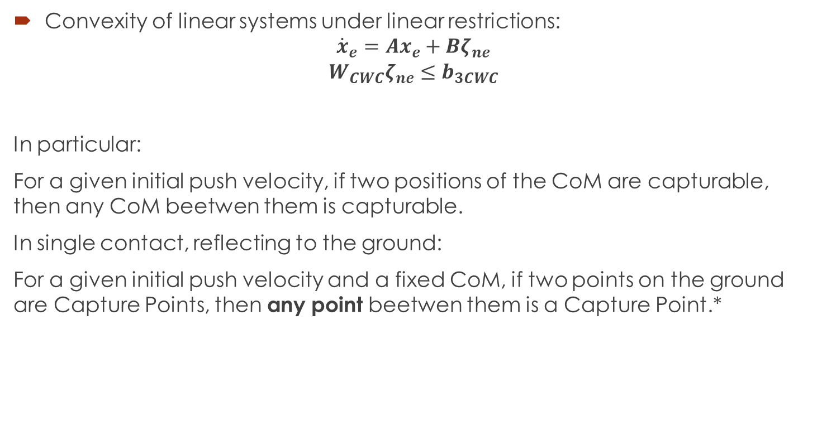
Full Reduced Inverted Pendulum
Convexity of linear systems under linear restrictions:
$${\dot{x}}_{e}=Ax_{e}+Bζ_{ne}$$
$$W_{CWC}ζ_{ne}≤b_{3CWC}$$
In particular:
For a given initial push velocity, if two positions of the CoM are capturable, then any CoM beetwen them is capturable.
In single contact, reflecting to the ground:
For a given initial push velocity and a fixed CoM, if two points on the ground are Capture Points, then any point beetwen them is a Capture Point.*

Slide 23
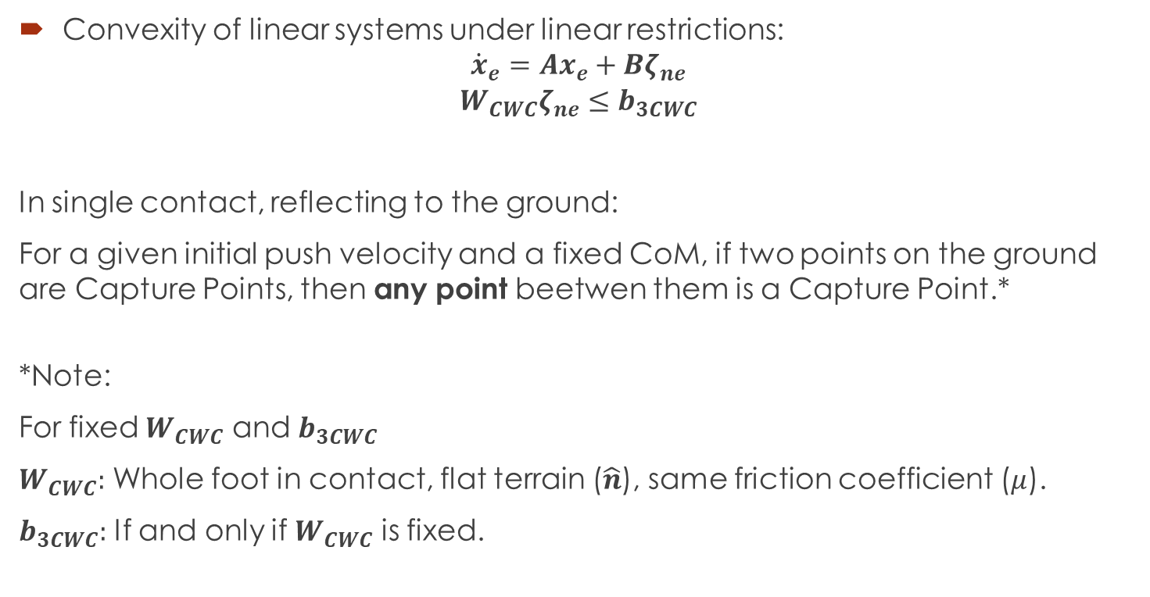
Full Reduced Inverted Pendulum
Convexity of linear systems under linear restrictions:
$${\dot{x}}_{e}=Ax_{e}+Bζ_{ne}$$
$$W_{CWC}ζ_{ne}≤b_{3CWC}$$
In single contact, reflecting to the ground:
For a given initial push velocity and a fixed CoM, if two points on the ground are Capture Points, then any point beetwen them is a Capture Point.*
*Note:
For fixed $W_{CWC}$ and $b_{3CWC}$
$W_{CWC}:$ Whole foot in contact, flat terrain ($\hat{n}$), same friction coefficient ($μ$).
$b_{3CWC}:$ If and only if $W_{CWC}$ is fixed.

Slide 24
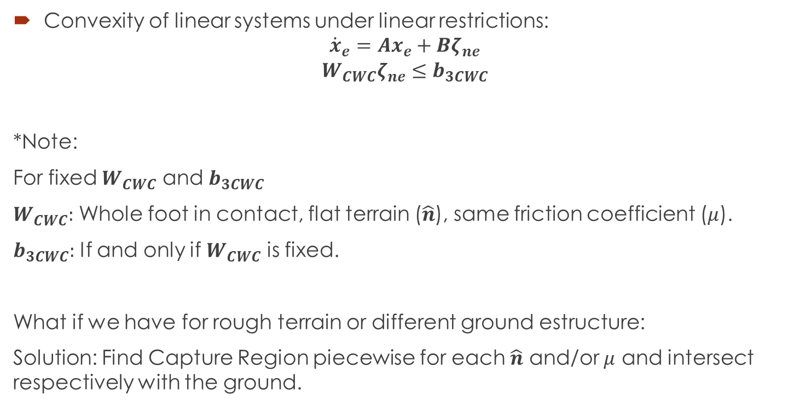
Full Reduced Inverted Pendulum
Convexity of linear systems under linear restrictions:
$${\dot{x}}_{e}=Ax_{e}+Bζ_{ne}$$
$$W_{CWC}ζ_{ne}≤b_{3CWC}$$
*Note:
For fixed $W_{CWC}$ and $b_{3CWC}$
$W_{CWC}:$ Whole foot in contact, flat terrain ($\hat{n}$), same friction coefficient ($μ$).
$b_{3CWC}:$ If and only if $W_{CWC}$ is fixed.
What if we have for rough terrain or different ground estructure:
Solution: Find Capture Region piecewise for each $\hat{n}$ and/or $μ$ and intersect respectively with the ground.

Slide 25

Full Reduced Inverted Pendulum
First idea: Optimization:
$$\min_{ζ_{ne}}{\frac{1}{2}\int_{0}^{∞}{x_{e}^{T}Qx_{e}+ζ_{ne}^{T}Rζ_{ne}dt}}$$
Subject to:
$${\dot{x}}_{e}=Ax_{e}+Bζ_{ne}$$
$$W_{CWC}ζ_{ne}≤b_{3CWC}$$
$$x_{e}\left(0\right)=x_{e0}$$
Convex problem!

Slide 26
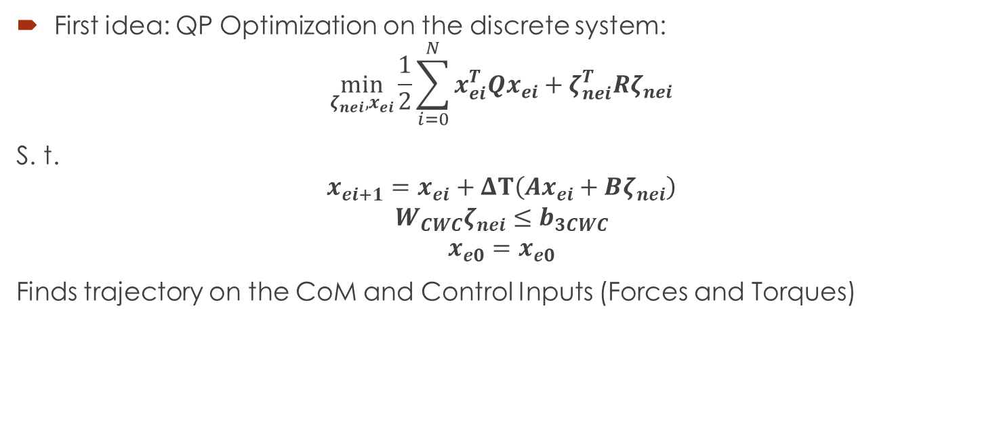
Full Reduced Inverted Pendulum
First idea: QP Optimization on the discrete system:
$$\min_{ζ_{nei}, x_{ei}}{\frac{1}{2}\sum_{i=0}^{N}{x_{ei}^{T}Qx_{ei}+ζ_{nei}^{T}Rζ_{nei}}}$$
S. t.
$$x_{ei+1}=x_{ei}+ΔT\left(Ax_{ei}+Bζ_{nei}\right)$$
$$W_{CWC}ζ_{nei}≤b_{3CWC}$$
$$x_{e0}=x_{e0}$$
Finds trajectory on the CoM and Control Inputs (Forces and Torques)

Slide 27

Convex Properties
Finding transversal surface for given ${\hat{F}}_{ext}$: Example of LP program:
1. Pick a random $r_{CoM0}$
2. Pick a random ${\hat{v}}_{j}$ holding ${\hat{v}}_{j}∙F_{ext}=0$. Can be defined by just an angle (1D).
3.$\max_{r_{CoM1},f}\left(r_{CoM1}−r_{CoM0}\right)∙{\hat{v}}_{j}$ s.t
$$W_{T}f_{CWC}=0$$
$$\left(r_{CoM1}−r_{CoM0}\right)∙W_{F}f_{CWC}=0$$
$$W_{CWC}f_{CWC}≤b_{CWC}$$
$$F_{ext}$$
$${\hat{v}}_{j}$$
$$r_{CoM1}$$
$$r_{CoM0}$$
$${\hat{v}}_{j}$$

Slide 28







LP for finding CoMs
Finding allowed CoMs for a fixed CWC (and fixed ${\dot{r}}_{0},L_{0}$): LP program:
1. Pick a random $r_{CoM0}$ (Stabilizable, example: a point on the static stability).
2. Pick a random ${\hat{v}}_{j}$. Can be defined by two angles (2D, i.e. angles from spherical coordinates).
3.$\max_{r_{CoM1},ζ_{nei},x_{ei}}\left(r_{CoM1}−r_{CoM0}\right)∙{\hat{v}}_{j}$ s.t
$$W_{CWC}ζ_{nei}≤b_{3CWC}$$
$$x_{ei+1}=x_{ei}+ΔT\left(Ax_{ei}+Bζ_{nei}\right)$$
$$x_{eN}=x_{ef}$$
$$x_{e0}=\left[\begin{aligned}L_{0}+m(r_{CoM1}×{\dot{r}}_{0}) \\ r_{CoM1}−r_{f} \\ {\dot{r}}_{0}\end{aligned}\right]$$
$$r_{CoM0}$$
$$r_{CoM1}$$
$${\hat{v}}_{j}$$
$${\hat{v}}_{j}$$
$$ζ$$

Slide 29


LP for finding CoMs
Capturable?
In flat terrain: Yes if the reflected region intersects the ground in one point and the whole foot is in full contact
In piecewise rough terrain: Yes if the reflected region for each normal vector intersects their respective “grounds”
$$r_{CoM1}$$
$$ζ$$

Slide 30

LP for finding CoMs
Additional detail: We can add bounds for the $(x,y,z)$ position based on kinematic limits. This helps and avoids possible divergences on the Computed Region (if there are no restrictions on the force for example).
$$r_{CoM1}$$
$$ζ$$

Slide 31
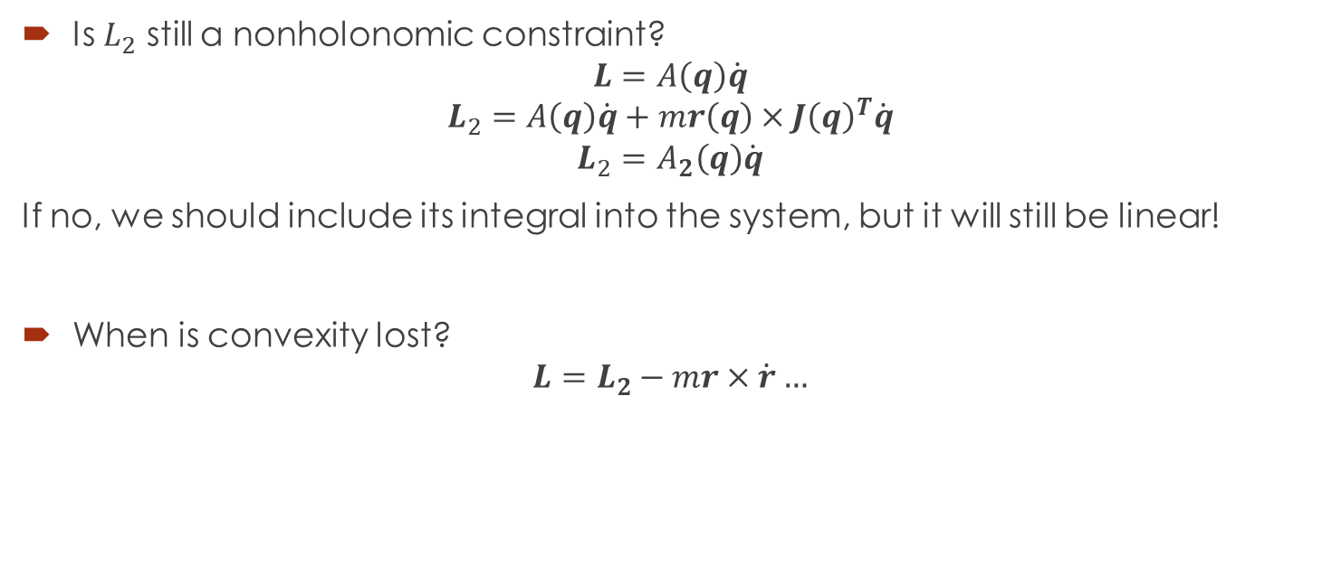
Some questions/Limitation
Is $L_{2}$ still a nonholonomic constraint?
$$L=A\left(q\right)\dot{q}$$
$$L_{2}=A\left(q\right)\dot{q}+mr\left(q\right)×J{\left(q\right)}^{T}\dot{q}$$
$$L_{2}=A_{2}\left(q\right)\dot{q}$$
If no, we should include its integral into the system, but it will still be linear!
When is convexity lost? $L=L_{2}−mr×\dot{r}…$

Slide 32
Some questions/Limitation
Feedback? No with this QP setup
Look for Feedback for Linear Systems with Linear Restrictions.
How can we get robustness?
Recompute each time i.e. Predictive Control.
A more “control” way: Use TVLQR
What if we have a hand?
Partial computing of CWC

